Slide 1
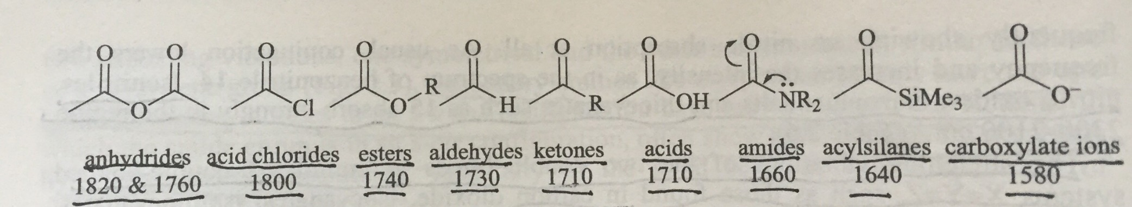

9) Carbonyl compounds
ν _{–C=O} around 1700-1800 cm⁻¹, very characteristic!
With other group IR signals to determine the derivative structures. (e.g. -N-H for amides)

Slide 2
Group | ν _{–C=O} (cm⁻¹) | Other signals
Ketones | 1700-1730 (s) | For aryl-/α,β-unsaturated ketones, red shift for 20-40 cm⁻¹
Aldehydes | 1720-1740 (s) | ~2740, 2850 (m) 2 fermi coupling
Carboxylic acids | 1680-1720 (br) | ν_{OH} 3200~2500 (br) δ_{OH} ~930 (br)
Carbonate salts | N/A | 1650-1550, 1440-1350, ν_{as} and ν_{s} of −COO⁻
Carboxylic anhydrides | 1745-1755 (s) 1815-1825 (s) (Vibration coupling)
Esters | 1730-1750 (s) | 1000-1300 two peaks, ν_{as} and ν_{s} of –C-O-C- (s)
Amides | Amide I: 1650-1690 (s) | ν_{NH} 3500～3050 (always spliting) Amide II: δ_{NH}1570-1649 (secondary amide < 1600, characteristic)
Acyl halides | 1790-1819

Slide 3
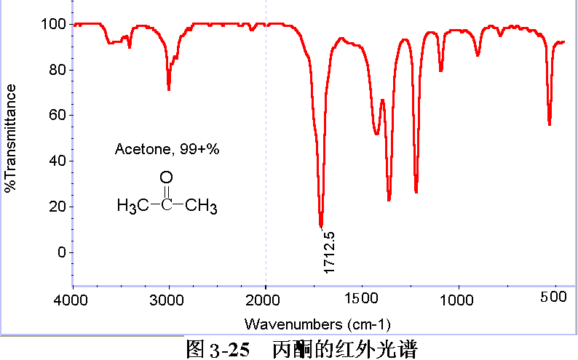
Acetone
Notes:
1715CM-1，芳酮或α, β-不饱和酮向低频位移20~40cm-1。1300~1100cm-1为羰基旁碳的骨架振动，但与其他单键的伸缩振动较难区别。

Slide 4
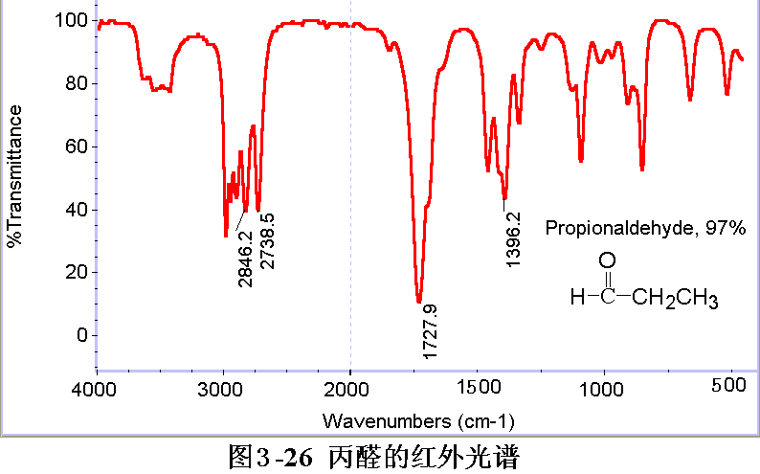
Propanal

Slide 5
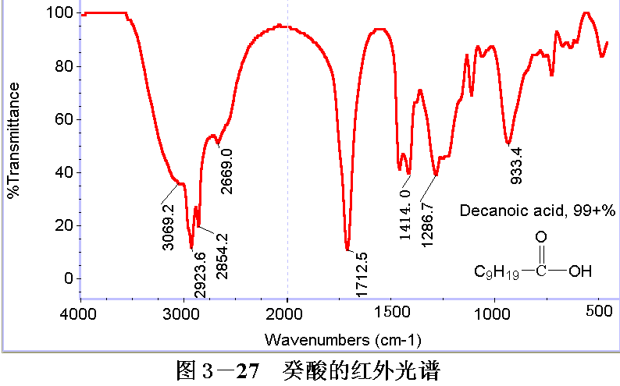
Decanoic acid

Slide 6
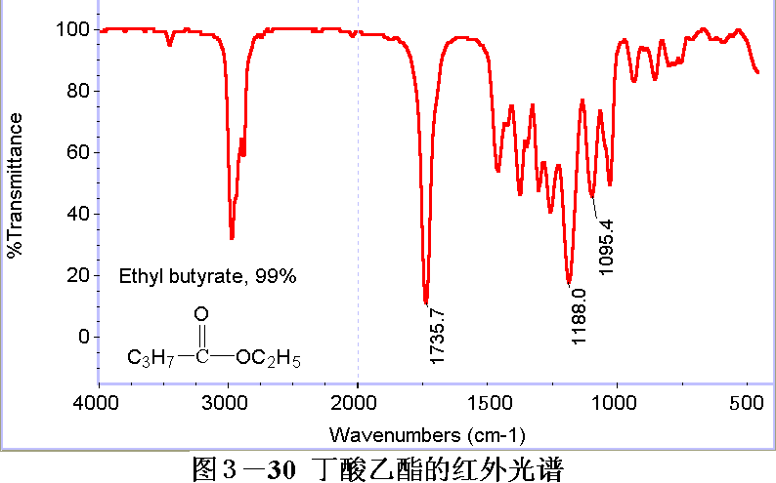
Ethyl butyrate

Slide 7
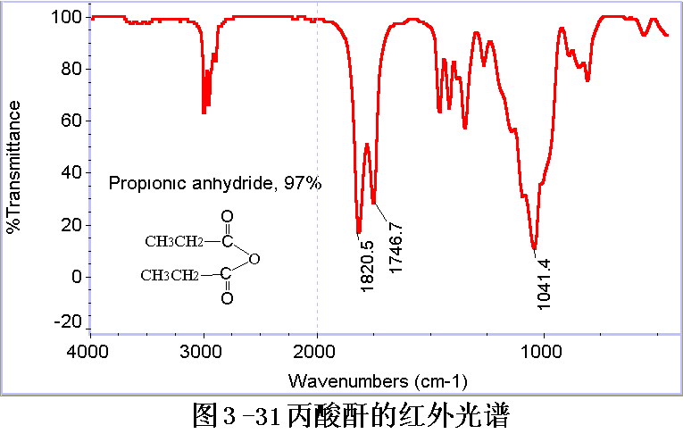
Propionic anhydride

Slide 8
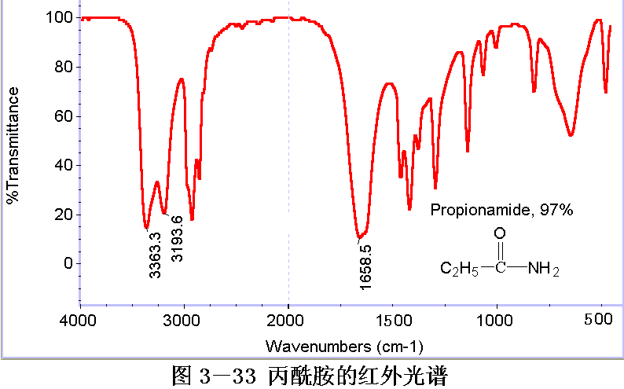
Propanamide
υ_{NH}: 3500～3050 cm⁻¹
Amide I：1690～1650 cm⁻¹， p-π conjugation is formed between lone pair electrons on N and carbonyl group，caused a red shift of ν_{C=O}.
Amide II： δ_{NH} 1649～1570 cm⁻¹. Amide II is often overlapped by Amide I in primary amides, while not for secondary amide whose Amide II is below 1600 cm⁻¹.

Slide 9
10) Others
Isocyanate, -N=C=O
Diazonium, -N≡N⁺
Allene, -C=C=C
Ketene, -C=C=O
Halide
Nitro, -NO₂
Sulfide, Silicide, Phosphide
Book: Page 117
Book: Page 115
Book: Page 119
Book: Page 119-120

